Slide 1


Types of
Operating Systems
Operating System

Slide 2
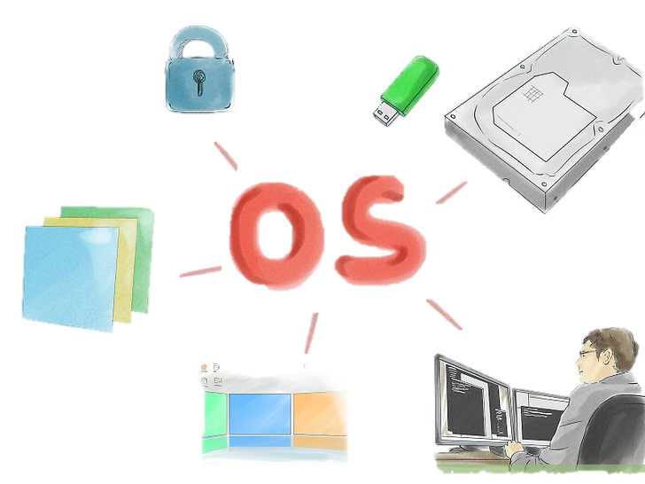
An operating system (OS) is system software that manages computer hardware, software resources, and provides common services for computer programs.
Memory management
security
User interface
Apps
Introduction about OS
Gui

Slide 3
History of Operating System

Slide 4
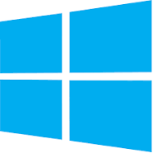
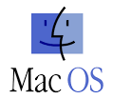



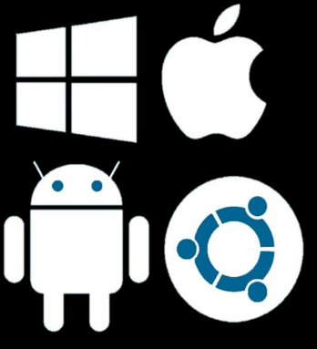
The IT industry largely focuses on the top five OSs, including Apple mac OS, Microsoft Windows, Google's Android OS, Linux Operating System, and Apple iOS
What are the 5 types of operating system?

